Slide 1
Adv Web Dev Arch Lecture 6 how to implement Microservices communication asynchronously (intro to promises in JS)
Amir Amintabar, PhD

Slide 2
Outline
1 Review
2 Asynch operations
3 Promises in JS
4 Promise status
5 .catch() and .finally()
6. In class activity
7. remarks on response size of GET vs POST requests
8. W3Schools website seems inaccurate
Quizzes on promise during labs, this week
No new labs this week. Next lab will be assigned after the midterm
Midterm exam administrated on Learning Hub
Closed book, one sheet of letter-sized paper both sides allowed

Slide 3
review
1
resource
myDomain.com/api/customers
Every http request has a verb or method that determines its intention
GET,PUT,DELETE,POST
PUT: replacing an object entirely with something new
PATCH: updating only a property of an object
PUT vs POST
PUT is idempotent, POST is not
calling PUT once or several times successively has the same effect (that is no side effect), whereas successive identical POST requests may have additional effects, e.g. leading to placing an order several times.
Idempotent: can be applied multiple times without changing the result

Slide 4
Remember in JS can a function receive another function as parameter? first-class functions
Example:
function foo(x) {
alert(x);
}
function bar(func) {
func("Hello World!");
}
//alerts "Hello World!"
bar(foo);

Slide 5
Remember Call backs
function myDisplayer(some) { document.getElementById("demo").innerHTML = some; } function myCalculator(num1, num2, myCallback) { let sum = num1 + num2; myCallback(sum); } myCalculator(5, 5, myDisplayer);
Example above says
"here are arguments to do sth with them in this function"
"here is the function to call once you are done"

Slide 6
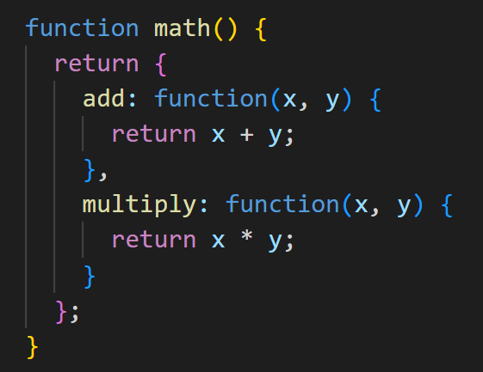
Function returning an object which has methods
Q: What does this function return?
( what data type?)
Q: how would you add two numbers using the code snipped above?
math().add(2,3)

Slide 7
Asyc operations and callback hell!
2

Slide 8
What if a function does asynchronous operations ?
Microservices communicate via the net using API calls
and any communication via net is asynchronous

Slide 9
This function returns an object with two methods, how can you call these methods? Depending on -1 or +1 you want to make a descisionn

Slide 10
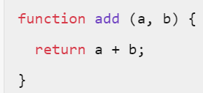
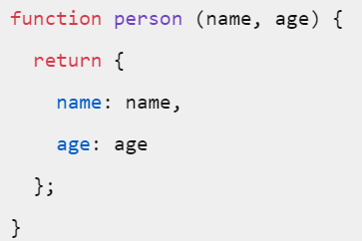

problem
In js Functions can only return a single value, whether of primitive data type (number, string etc) or a non- primitive data type such as an object.
Usually, we call the function in our code, and do stuff based on the retuned value. But what if the operation performed by a function is asynchronous?
Q: why functions doing asynchronous operations are more complicated?

Slide 11
Dealing with functions doing asynchronous stuff, we are not only interested in the returned value, but also in how it was returned, was the operation successful or failed ( timed-out, DB is down, authentication error etc)
1- Do something with the success
2- Or deal with the failure gracefully
But functions return only one thing! (read with scream)
Q: Whats your solution ?
Lets simply return an object that has two callback methods, resolve() and reject()! We simply override them based on what we want ☺

Slide 12
Promise in JavaScript
3

Slide 13
Understanding promises

Slide 14
Understanding Promises
"Imagine yourself working in a company. Your boss promises you a raise someday.
You don't know if you will get that raise until next quarter, you just wait(pending). Your boss can either really get you the raise(fulfilled), or stand you up and withhold (reject)it if she/he is not happy :(.
That is a promise. A promise has 3 states:
Pending: You don't know if you will get the raise
Resolved (Fulfilled): Boss is happy, gets you the raise. describe what you would do in a function called resolve()
Rejected: Your boss is unhappy, withholds the raise. Lets describe what you would do in a function called reject()

Slide 15
Remember the three possible status of a JS promise
Pending
Fulfilled
Rejected
Settled

Slide 16
Js runs asynchronously. That means you never exactly know when things happen. Remember the restaurant with single waiter analogy. When you ask the waiter for sth, you never know when he is going to get back to you.
You only get a promise. (he might get back to you , he might forget)
When you make an AJAX call you never know when you are going to get back the result. Imagine other part of your code is pending for the result of this AJAX.

Slide 17
Promise() is an object in JavaScript
The Promise object is used for asynchronous computations.
A Promise represents a single asynchronous operation that hasn't completed yet, but is expected in the future.
You pass a function to the constructor which gets executed the moment the promise object gets created
The executer function gets two functions ( resolve and reject) as input
The Promise object has a method called then()
let promise = new Promise( myExecuter( res(),rej() ) );

Slide 18
Promise object constructor
1. Promise constructor to which we can pass a function called executer. This function itself gets two functions first one points to resolve, the second one points to reject
let promise = new Promise(
(resolve, reject)=> {
// some condition to decide outcome of promise (reject or resolve)
reject("Rejected!");
resolve("Resolved!");
}
);
promise.then(
(resolveMes)=> {
console.log(resolveMes);
}
,
(rejectMes)=> {
console.log(rejectMes)
}
);
3. Promise executer function. Gets executed immediately upon creation of the promise object
4. Resolve and reject are invoked asynchronously and mutually exclusive
And run only once
2. Definition of the two functions resolve and promise are given here, or could be given elsewhere but passed by reference
In this example, when reject invokes, the resolve will be ignored because the promise is already settled.
5. The then() method itself returns a promise
Note: blue color indicates resolve contents, Red indicates reject ones

Slide 19
Eager vs lazy
Promises are eager. This means that when a new Promise is constructed, it immediately starts executing, attempting to resolve the asynchronous value ( meaning the resolve, reject methods are called asynchronously by a synchronous executer method )

Slide 20
Promise Examples
4

Slide 21
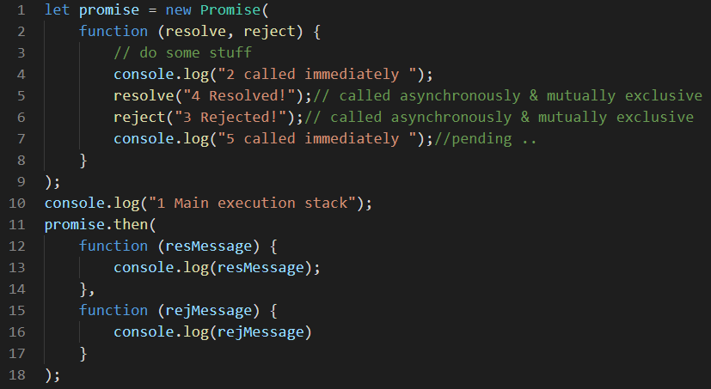
Example 1:
A:
2 ( we said the executor will invoke the moment the promise constructor is called.
5 ( 2 and 5) execute synchronously
1 then this like executes synchronously as it is in the same execution stack
4 invokes asynchronously and mutually exclusive which means the main execution stack finishes first, then one of these two the invokes first, will block the other one from execution .
In what order the strings below will be logged?

Slide 22
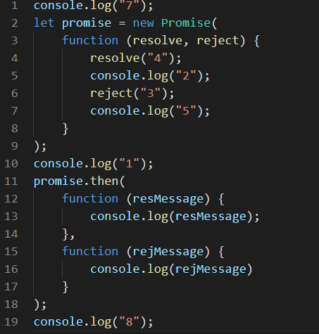

Example 2: in what order the numbers will be logged?

Slide 23
Q: In what order the console logs the numbers?
Example 3
let promise = new Promise(
function (resolve, reject) {
console.log(" 2 ");
reject(" 3 ");
resolve(" 4 ");
console.log(" 5 ");
}
);
promise.then(
function (st) {
console.log(st);
},
function (st) {
console.log(st)
}
);
console.log(" 1 ");
A:
2
5
1
3
Q: what happened to 4?

Slide 24
Example 5: How many times 'Hi' will be logged?
// How many times "Hi" will be logged?
let promise = new Promise((res) => {
setInterval(() => {
res("Hi");
}, 100);
});
promise.then((mes)=>{console.log(mes)});
Tip: Remember we said promises are either pending or settled (settled: resolved or rejected). Once they are settled, their state will not change
If the promise has already been resolved to a value to a rejection or to another promise,
then the res method does nothing .
A: Hi will be logged only once.

Slide 25
Example 6:
Promise.resolve() and Promise.reject() are shortcuts to manually create an already resolved or rejected promise respectively.
In what order the numbers will be logged?
Promise.resolve().then(() => console.log(1)); console.log(2);
Remember the note in the gray slide about functions passed to then(), which means resolve and reject, will never be called synchronously, even with an already-resolved promise
Therefore the order is:
2
1

Slide 26
Chaining promises
If you remember the note 5 of the gray slide, The then() method returns a Promise. That’s why we can chain promises .
The then() method returns a Promise. It takes up to two arguments: callback functions for the success and failure cases of the Promise
function return (new Promise) ).then(()=>{return (new Promise)}).then
promise.then()

Slide 27
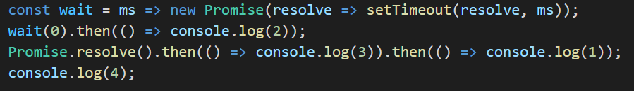
Example 7
In what order the numbers will be logged?
Notes:
const wait = ms => new Promise(resolve => setTimeout(resolve, ms));
wait(0).then(() => console.log(2));
Promise.resolve().then(() => console.log(3)).then(() => console.log(1));
console.log(4);

Slide 28
Example 8 ( in-class activity)
f1 = () =>{console.log(1)};
f2 = () =>{console.log(2)};
f3 = () =>{console.log(3)};
// async() does things asynchronously for us
function async(callMeBack) {
setTimeout(() => {
callMeBack();
}, Math.floor(Math.random() * 1000)
);
}
//we want f1,f2 and f3 execute in f1,f2, f3
// asynchronously How can we guarantee ?
// would below work? if not what to do?
async(f1);
async(f2);
async(f3);
we want f1,f2 and f3 execute in f1,f2, f3
asynchronously How can we guarantee ?
would below work? if not what to do?

Slide 29
Lets observe how promise status changes
5

Slide 30
Try this code
and observe the changes in the property values of the instantiated promse object over time
const prom = new Promise( (res, rej)=>{
setTimeout(() => {
res('status changed now!');
}, 5000);
})

Slide 31
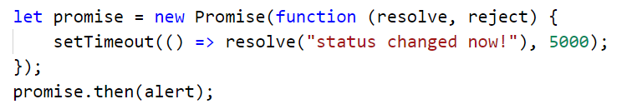
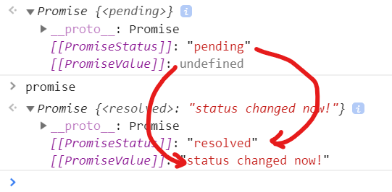
Example: observe how status and value change after 5 sec
After around a 5 second gap, the status changes from pending to resolved

Slide 32

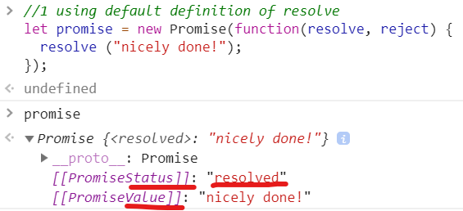
Example 9: using default definition of resolve method
what will be the status and value of the object promise after execution of this code?

Slide 33
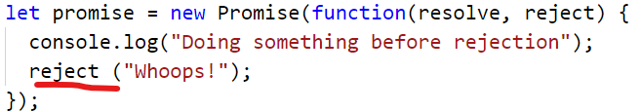
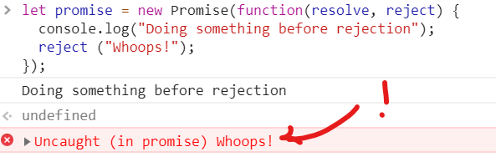
Example 10: using default definition of reject method
what will be the status and value of the object promise after execution of this code?
Why?
Because we did not catch the error ( we did not define the reject method)! The js engine throws the error using default definition of reject! In fact rejection naturally means something went wrong

Slide 34
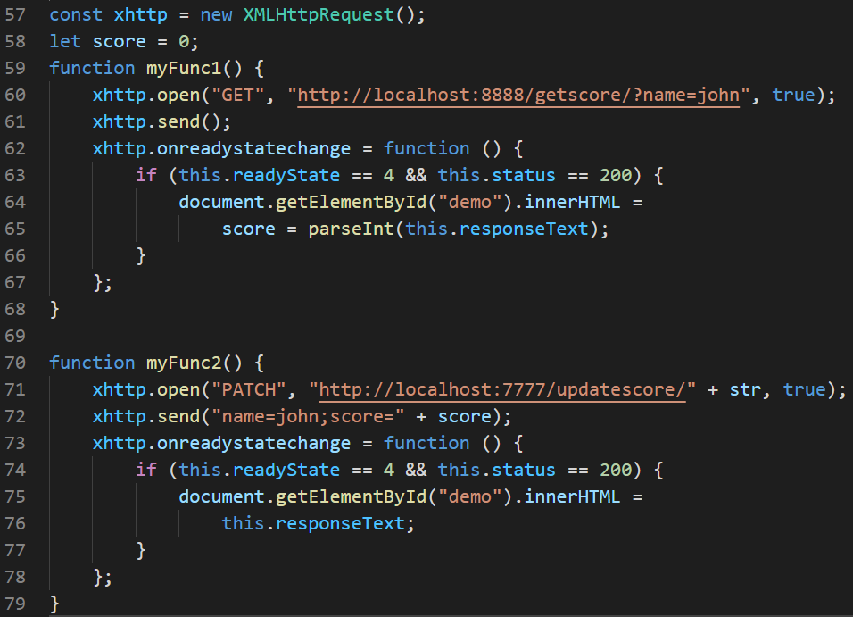
Q: How to execute two successive AJAX calls (second one only after first one is guaranteed finished)?
Suppose we wish to
make an Ajax call to server A to get something
And then
making another AJAX call to server B based on what you got from server A.
Q: How can you guarantee the right order?
A: calling myFunc2 inside myFunc1, line 65
Have you heard about callback hell?

Slide 35
.then .catch .finally
6
.finally
3 main methods of the Promise object are

Slide 36
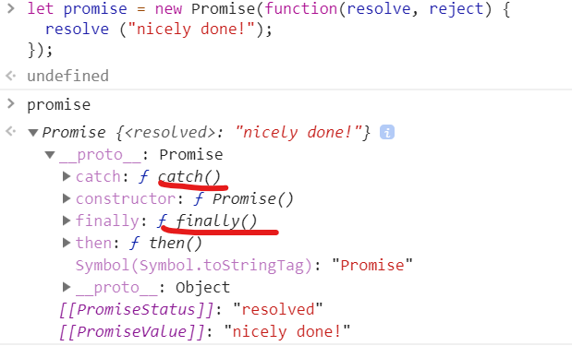
What are these methods?

Slide 37
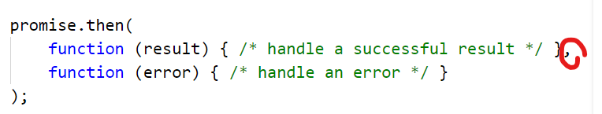
.then method ( we already know)
The first argument of .then is a function that:
runs when the Promise is resolved, and
receives the result.
The second argument of .then is a function that:
runs when the Promise is rejected, and
receives the error.

Slide 38
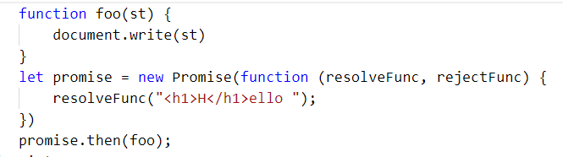
Example: What’s the output of the code below?
A: When we pass only one function to .then method, that function replaces the default definition of resolve method
So the code above will display 1 on the browser window

Slide 39
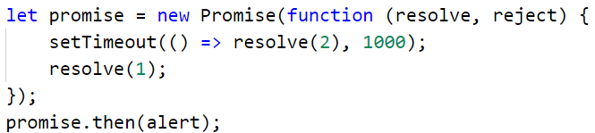
Example: What’s the output of the code below?
it will alert “1” on the browser window and ignore the second resolve

Slide 40
.catch method
If we’re interested only in errors, then we can use null as the first argument:
.then(null, errorHandlingFunction)
Is the same as
.catch(errorHandlingFunction)

Slide 41
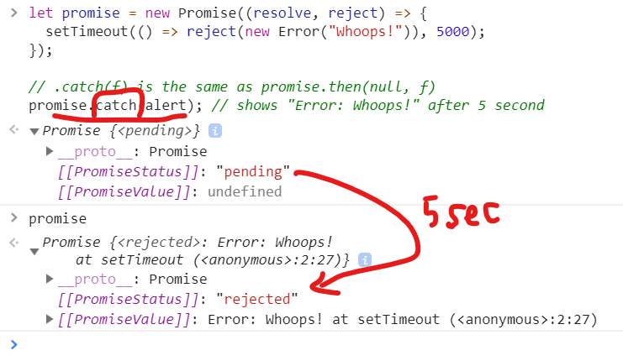
.catch example

Slide 42
.finally
Just like there’s a finally clause in a regular try {...} catch {...}, there’s finally in promises.
The call .finally(f)
is similar to
.then(f, f)
in the sense that it always runs when the promise is settled: be it resolve or reject. (src: javascript.info)
Note: there are more into .finally method that is outside the scope of this class.

Slide 43
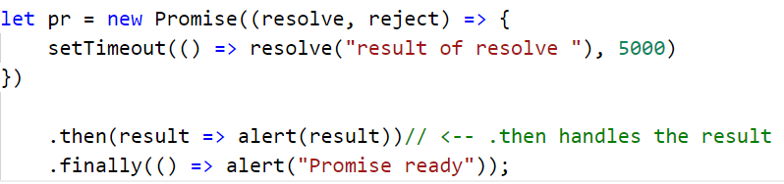
.finally method example
Remember if resolve function executes, reject function will be ignore and vice versa. However regardless of how the promise settles the finally method will be called

Slide 44

.finally method example 2
Remember if resolve function executes, reject function will be ignore and vice versa. However regardless of how the promise settles the finally method will be called .
In example below we did not catch error nor we defined reject function.
Remember the default function would terminate the script

Slide 45
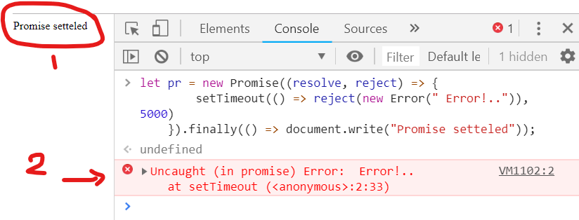
.finally method example 2 cont…

Slide 46
Async/Await
built on top of promises, allowing you to write asynchronous code that looks more like synchronous code.
async: When a function is declared as async, it automatically returns a promise.
await: This is used inside async functions to wait for a promise to resolve or reject.
Good exapls at https://www.w3schools.com/js/js_async.as

Slide 47
In class activity
6
Q1: For the given API server, measure the time diff from the time you sent a GET request, to the time you receive the response Q2: Measure the time diff from the time you receive the response header, to the time you receive the response

Slide 48
GET vs POST
So we stated that there is a limitation on data size being sent over a single GET request. However, there is no such limitation on POST request
Q: what about the responses of GET vs POST? Is there such limit for their responses too?
A: no! There are no standardized limitations on the size of responses for GET or POST requests specified by the HTTP protocol. Needless to mention practical limitations can be influenced by server configurations, network constraints, or browser limitations.
7

Slide 49
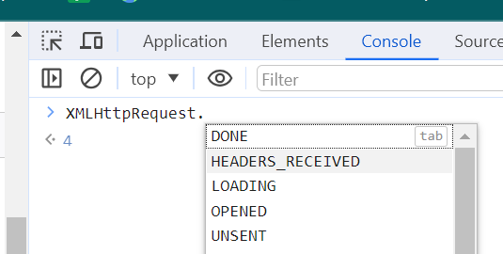
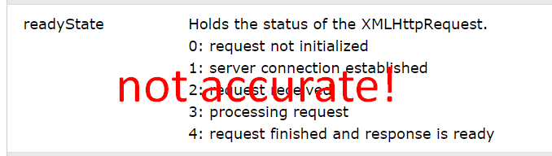
W3schools is inaccurate about onreadystatechanged
Turns out https://www.w3schools.com/xml/ajax_xmlhttprequest_response.asp is not accurate on ready states status values ! The one we covered in lecture is accurate
Accurate one: 0 (UNSENT): The XHR object has been created, but open() has not been called yet.
1 (OPENED): open() has been called.
2 (HEADERS_RECEIVED): send() has been called, and the headers of the response are available.
3 (LOADING): The response is being received. As data comes in, the responseText property is updated.
4 (DONE): The operation is complete, and either the request has been successfully completed (status code 2xx) or an error occurred.
So verified that by looking into the XMLHttpRequest class properties manually in Chrome Dev tool
8

Slide 50
References and resources
https://scotch.io/tutorials/javascript-promises-for-dummies#toc-chaining-promises
Spring.io
MDN mozlla
https://medium.com/front-end-weekly/ajax-async-callback-promise-e98f8074ebd7
https://zapier.com/learn/apis/chapter-6-api-design/
https://restfulapi.net/versioning/
RESTful Web API Design with Node.js 10 - Third Edition
https://phil.tech/2016/http-rest-api-file-uploads/ ( for your term project)
chatGPT

